Slide 1

BMS INSTITUTE OF TECHNOLOGY & MANAGEMENT (An Autonomous institution under VTU, Belagavi) Avalahalli Doddaballapura Main Road, Yelahanka, Bangalore-64 Department of MCA Major Project [22MCA403]
DIGITALIZATION OF THE MCA DEPARTMENT
STUDENT NAME : SHASHANK K USN: 1BY22MC047
DATE OF SUBMISSION: 18/05/2024
INTERNAL GUIDE:
DR SHIVAKUMARA T
ASSISTANT PROFFESER OF MCA DEPT
BMSIT

Slide 2
VISION
To develop quality professionals in Computer Applications who can provide sustainable solutions to the societal and industrial needs.
MISSION
Facilitate effective learning environment through quality education, state-oftheart facilities, and orientation towards research and entrepreneurial skills.
Program Educational Objectives (PEOs)
PEO 1: Develop innovative IT applications to meet industrial and societal needs.
PEO 2: Adapt themselves to changing IT requirements through life-long
learning.
PEO 3: Exhibit leadership skills and advance in their chosen career.

Slide 3
Program Outcomes (POs)
PO 1: Apply knowledge of computing fundamentals, computing specialization, mathematics and domain knowledge to provide IT solutions.
PO 2: Identify, analyze and solve IT problems using fundamental principles of mathematics and computing sciences.
PO 3: Design, Develop and evaluate software solutions to meet societal and environmental concerns.
PO 4: Conduct investigations of complex problems using research-based knowledge and methods to provide valid conclusions.
PO 5: Select and apply appropriate techniques and modern tools for complex computing activities.
PO 6: Understand professional ethics, cyber regulations and responsibilities.
PO 7: Involve in life-long learning for continual development as an IT professional.
PO 8: Apply and demonstrate computing and management principles to manage projects in multidisciplinary environments by involving in different roles.
PO 9: Comprehend & write effective reports and make quality presentations.
PO 10: Understand the impact of IT solutions on socio-environmental issues.
PO 11: Work collaboratively as a member or leader in multidisciplinary teams.
PO 12: Identify potential business opportunities and innovate to create value for the society and seize that opportunity.

Slide 4
Course Outcomes (COs)
CO 1: Review the existing literature to identify and formulate the problem in contemporary technologies/ issues related to society/environment which leads to development of IT solution.
CO 2: Analyze the requirements and prepare Software requirement specifications (SRS) document as per IEEE format in consistency with the problem defined.
CO 3: Create models that are consistent with the requirements specified in the SRS.
CO 4: Develop the solution by applying appropriate techniques, software engineering and management principles and modern tools to meet the requirements either as an individual or by involving in team.
CO 5: Verify & validate the data and results to arrive at valid conclusions and communicate the work done
effectively in terms of presentations, writing reports and research article as per the format given.
CO 6: Follow ethical principles in all stages of project work by avoiding plagiarism.
CO 7: Articulate the impact of IT solutions developed in the project work with respect to societal, environmental and industrial issues

Slide 5
AGENDA
Introduction
Literature survey
Existing & Proposed System
System Architecture
Class Diagrams
Use Case Diagrams
System Design & Database Design
Test Cases
User-Screenshots
Open For Discussion
Conclusion

Slide 6
1.Introduction
The digitalization of the MCA Department represents a strategic initiative aimed at optimizing resource utilization and improving overall efficiency. Through the deployment of standardized PCs or laptops, equipped with robust processors and adequate RAM, the department ensures that students and faculty have access to reliable computing power. This hardware infrastructure supports the integration of various software applications essential for curriculum delivery, research endeavours, and administrative tasks. Compatibility with major operating systems such as Windows further enhances flexibility, accommodating diverse user preferences and technical requirements within the department.

Slide 7
Frontend technologies like HTML5, CSS3, and JavaScript form the foundation for developing intuitive and visually appealing interfaces for both educational content delivery and administrative functions.
HTML5 provides a structured approach to content presentation, facilitating clarity and accessibility across different devices and screen sizes.
CSS3 enhances the aesthetics of the department's digital platforms, ensuring a cohesive and engaging user interface through advanced styling and layout techniques.
JavaScript, meanwhile, enables dynamic interactions and real-time updates, enriching user engagement and functionality.
Backend technologies play a pivotal role in supporting the robust infrastructure required by the MCA Department.
Python, renowned for its versatility and readability, serves as the primary programming language underpinning backend development.
Django, a powerful Python framework, provides the necessary tools for rapid application development and secure data.
Furthermore, the digitalization of administrative processes within the MCA Department aims to streamline workflows, reduce paperwork, and improve operational efficiency.

Slide 8
2. Literature survey
The digitalization of departments, including MCA departments, is increasingly recognized for enhancing operational efficiency and user experience through integrated hardware and software systems.
Key components include modern hardware with multicore processors, sufficient RAM, and compatibility with major operating systems and web browsers.
Software stacks typically include HTML5 for structured content, CSS3 for visual appeal, JavaScript for dynamic frontend functionalities,
Django for secure backend operations leveraging Python, and SQL lite databases for reliable data management.

Slide 9
3. Existing & Proposed System
The current system in MCA departments often relies on traditional manual methods for appointment scheduling and data management.
It may lack integration, resulting in inefficiencies, data redundancies, and delays in patient care and administrative processes.
This system typically operates on basic hardware setups with limited computing power and outdated software tools, hindering optimal departmental functioning and user satisfaction.
The proposed digitalization initiative aims to revolutionize MCA department operations by implementing a comprehensive system.
This includes deploying modern desktops or laptops with advanced hardware specifications, compatible with diverse operating systems and web browsers.
Software components will feature HTML5 for structured content, CSS3 for enhanced user interfaces, Django for robust backend development using Python, and SQL databases for secure data storage and retrieval.
This integrated approach seeks to streamline operations, improve patient care delivery, and ensure scalability and security for future departmental needs.

Slide 10
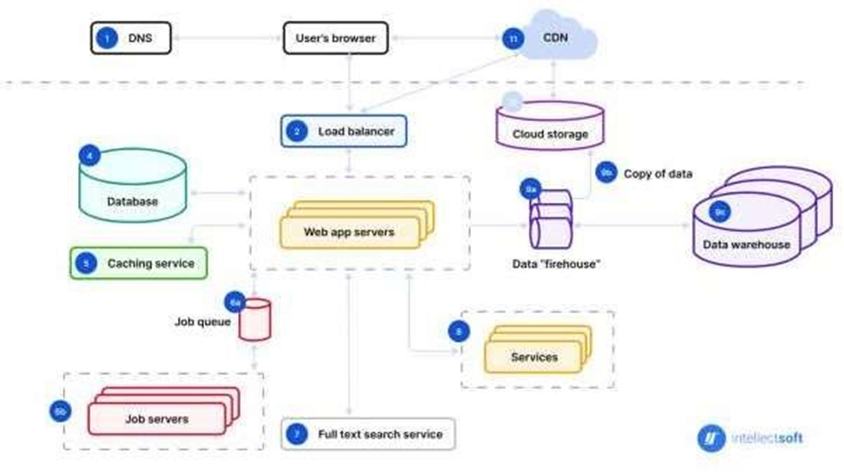
4. System Architecture

Slide 11
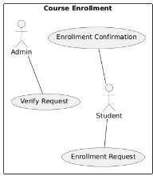
5. Class Diagrams
5.1 Dataflow diagram
Figure 5.1.1 Course Enrolment Data Flow Diagram
Description:
This use case diagram represents the process of course enrolment.
It involves two primary actors: the Admin and the Student.
The student initiates the process by submitting an Enrolment Request.
The admin then verifies the request through the Verify Request use case.
Upon successful verification, the Enrolment Confirmation is issued, completing the enrolment process.

Slide 12
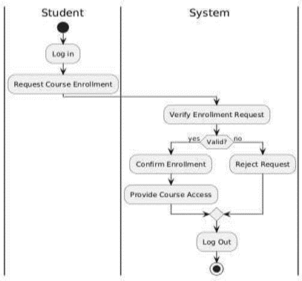
5.2 Activity diagram
Figure 5.2.1 Course Registration
Description:
This activity diagram illustrates the course registration process involving a student and the system.
The student initiates the process by logging into the system.
The system then displays the available courses, and the student selects the desired course.
Upon selection, the system checks the prerequisites and available slots.
If the prerequisites are met and slots are available, the system registers the student for the course and updates the database.
Finally, the system confirms the registration to the student.

Slide 13
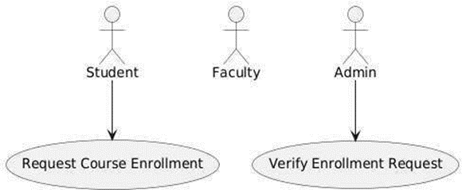
6. Use Case Diagrams
5.3.1 Course Enrolment for Student
Description:
This use case diagram illustrates the course enrolment process involving three primary actors: Student, Faculty, and Admin.
The process begins with the student submitting an Enrolment Request.
The admin is responsible for verifying the request through the Verify
Request. Once the request is verified, the Enrolment Confirmation is issued to the student.
Faculty may also be involved in the process for approval or additional verification steps, ensuring a comprehensive and structured enrolment procedure.

Slide 14
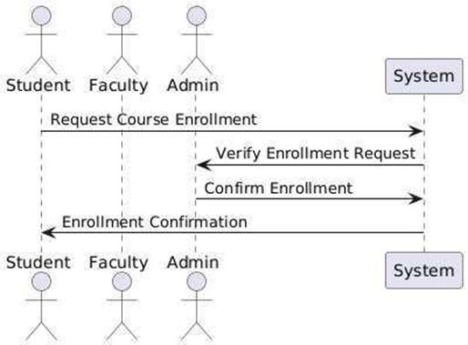
7. System Design & Database Design
Description:
This sequence diagram illustrates the course registration process involving three primary actors:
the Student, Faculty, and Admin.
The process begins with the student sending a course registration request to the faculty.
The faculty reviews and approves the request, forwarding it to the admin for final verification.
The admin confirms the registration, and a confirmation is sent back to the student, completing the registration process.
Figure 5.4.1 Course Registration Enrolment and Confirmation

Slide 15
8. Test Cases
Test cases define specific scenarios to be tested, including expected inputs and outputs.
Examples of test cases include:
User Authentication: Verify login functionality with valid and invalid credentials.
Course Management: Test course creation, modification, and deletion processes.
Data Management: Validate data entry, modification, and retrieval operations.
System Performance: Measure response times under varying loads to ensure the system meets performance criteria.

Slide 16
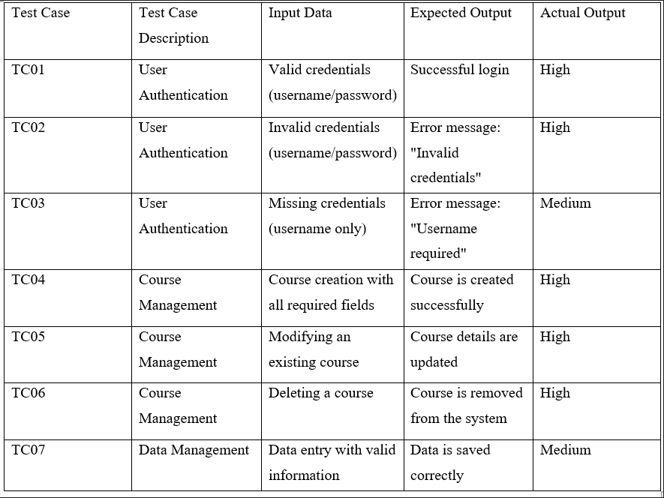
Table 7.3.1 Test Case Result

Slide 17





9.User-Screenshots

Slide 18
10.Open For Discussion
Current Challenges: Outline the existing challenges or inefficiencies in the MCA department that digitalization aims to address.
Proposed Digital Solutions : Student Information System: Implement a centralized system for managing student records, grades, attendance, and communication.
Online Learning Management: Use platforms for course management, online classes, and assignments submission.
Automated Administrative Tasks: Automate tasks such as admissions, scheduling, and faculty evaluations to streamline operations.
Data Analytics: Integrate tools for analyzing student performance, departmental metrics, and resource utilization.
Benefits of Digitalization : Efficiency: Reduced manual workload and faster processing of tasks.
Accessibility: Improved access to information and resources for both students and faculty.

Slide 19
11.Conclusion
The digitalization journey of the MCA Department represents a pivotal transformation that has significantly enhanced its educational landscape, operational efficiencies, research capabilities, and overall student outcomes.
Through strategic investments in technology infrastructure, adoption of digital tools, and cultivation of a collaborative learning environment, the department has successfully navigated the challenges and opportunities presented by the digital age.
Central to the success of digitalization initiatives has been the focus on enhancing learning experiences for students.
This approach not only fosters deeper understanding of theoretical concepts but also cultivates critical thinking, problem-solving skills, and creativity essential for their future careers in the IT industry.
Administratively, digitalization has streamlined processes, reducing administrative burdens and optimizing resource allocation.
Automation of routine tasks such as course registration, scheduling, and grading has enabled faculty and staff to devote more time to academic support and strategic initiatives.
Integrated management systems have facilitated data-driven decision- making, enhancing transparency, accountability, and operational effectiveness within the department.

Slide 20
Furthermore, digitalization has positioned the MCA Department as a hub of research excellence by providing faculty and students with access to advanced research tools, databases, and collaborative platforms.
This has catalyzed interdisciplinary research collaborations and accelerated knowledge discovery in emerging fields like artificial intelligence, cybersecurity, and data science.
The increase in research outputs, publications, and partnerships underscores the department's commitment to advancing knowledge and innovation in the IT domain.
Inclusivity and accessibility have also been prioritized through digitalization efforts, ensuring that all students, regardless of physical abilities or learning preferences, can fully participate in and benefit from educational opportunities.
By adopting universal design principles and leveraging assistive technologies, the department has created an inclusive learning environment that supports diverse student needs and promotes equity in education

